Slide 1
Office Computer Application WEEK EIGHT
Muhammad Unggul Pamenang

Slide 2
Please Do It With MS PowerPoint from 2010 - 2016

Slide 3
Charts
1
MS PowerPoint 2016

Slide 4
Introduction
A chart is a tool you can use to communicate data graphically. Including a chart in a presentation allows your audience to see the meaning behind the numbers, which makes it easy to visualize comparisons and trends.

Slide 5
Types of charts
PowerPoint has several types of charts, allowing you to choose the one that best fits your data. In order to use charts effectively, you'll need to understand how different charts are used.

Slide 6
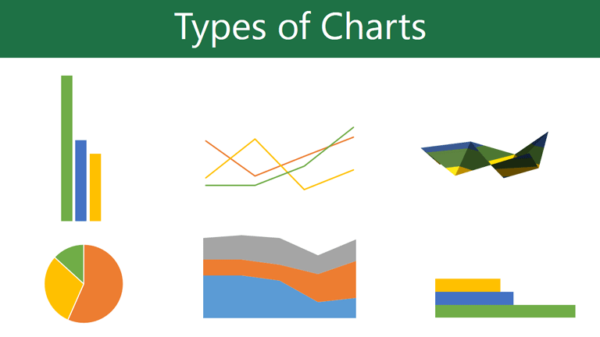
Types of charts
PowerPoint has a variety of chart types, each with its own advantages. Click the arrows to see some of the different types of charts available in PowerPoint.

Slide 7
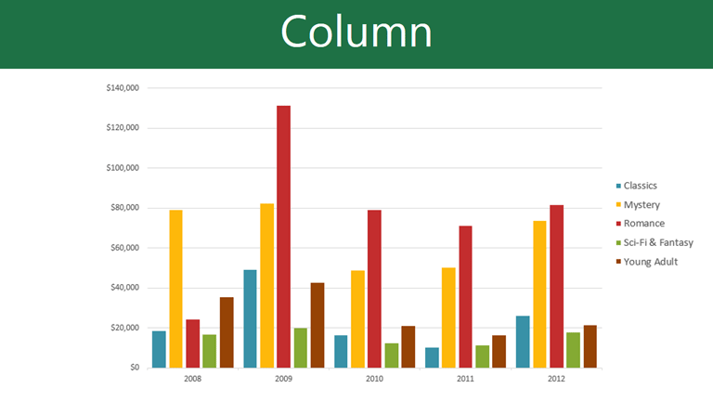
Types of charts
Column charts use vertical bars to represent data. They can work with many different types of data, but they're most frequently used for comparing information.

Slide 8
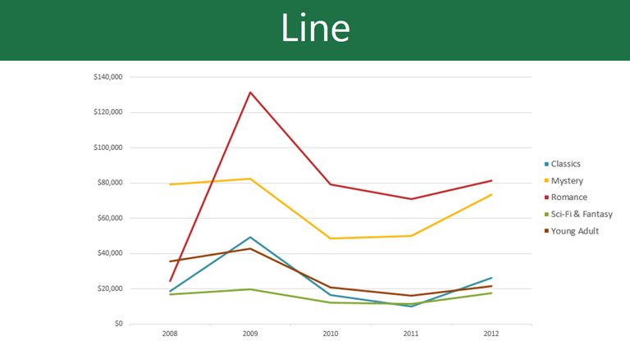
Types of charts
Line charts are ideal for showing trends. The data points are connected with lines, making it easy to see whether values are increasing or decreasing over time.

Slide 9
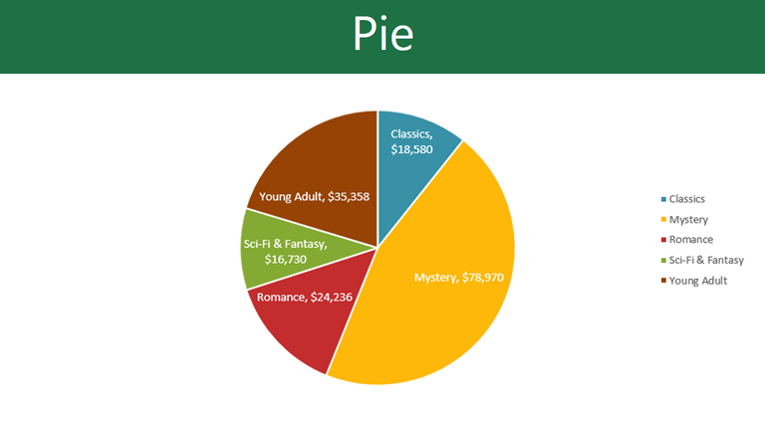
Types of charts
Pie charts make it easy to compare proportions. Each value is shown as a slice of the pie, so it's easy to see which values make up the percentage of a whole.

Slide 10
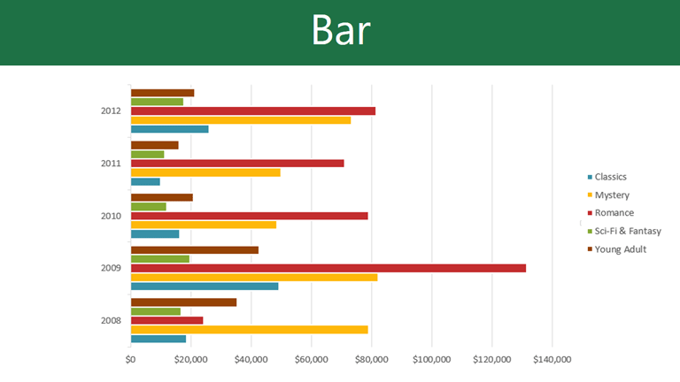
Types of charts
Bar charts work just like column charts, but they use horizontal bars instead of vertical bars.

Slide 11
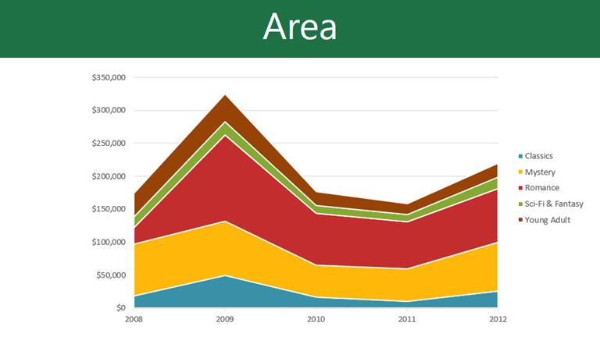
Types of charts
Area charts are similar to line charts, except the areas under the lines are filled in.

Slide 12
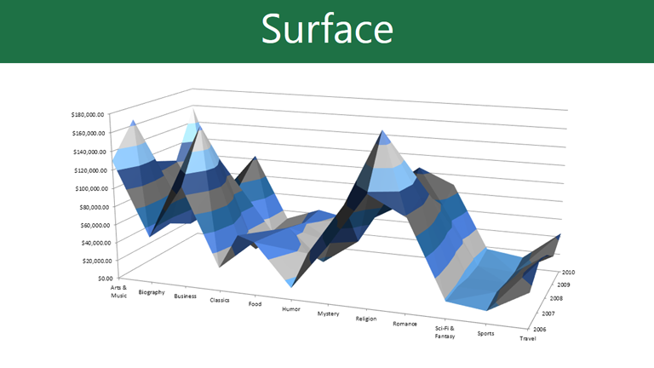
Types of charts
Surface charts allow you to display data across a 3D landscape. They work best with large data sets, allowing you to see a variety of information at the same time.

Slide 13
Identifying the parts of a chart
In addition to chart types, you'll need to understand how to read a chart. Charts contain several different elements—or parts—that can help you interpret data.

Slide 14
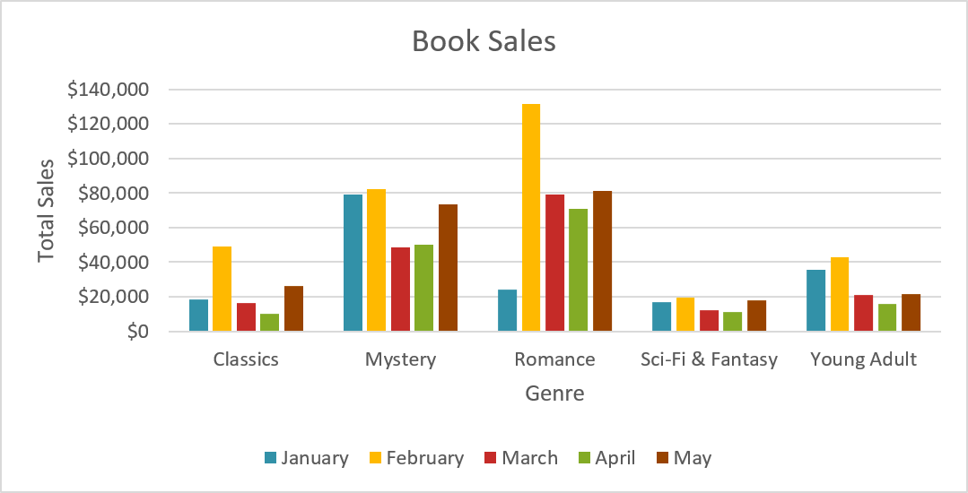
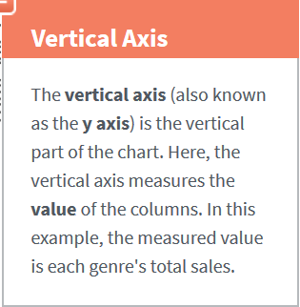
Identifying the parts of a chart

Slide 15
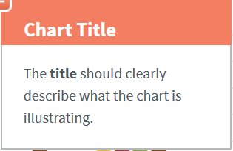
Identifying the parts of a chart

Slide 16
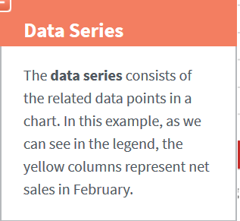
Identifying the parts of a chart

Slide 17
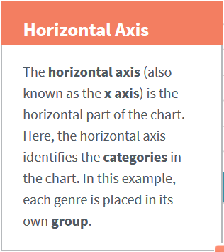
Identifying the parts of a chart

Slide 18
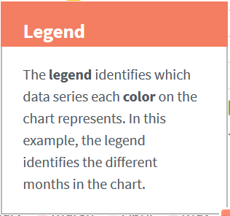
Identifying the parts of a chart

Slide 19
Inserting charts
PowerPoint uses a spreadsheet as a placeholder for entering chart data, much like Excel. The process of entering data is fairly simple.

Slide 20
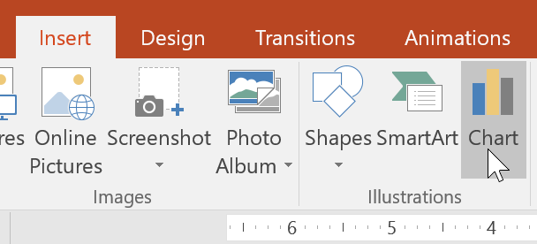
To insert a chart:
Select the Insert tab, then click the Chart command in the Illustrations group.

Slide 21
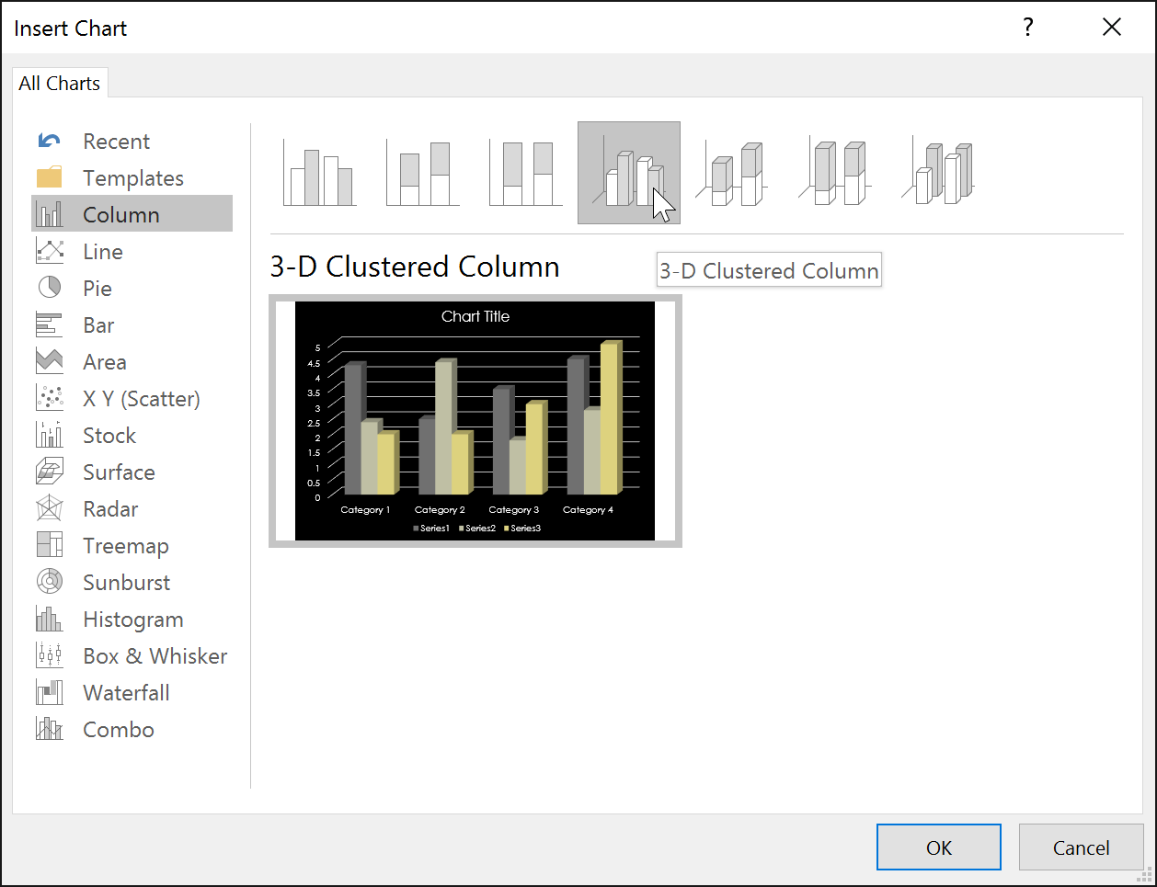
To insert a chart:
A dialog box will appear. Select a category from the left pane, and review the charts that appear in the right pane.
Select the desired chart, then click OK.

Slide 22
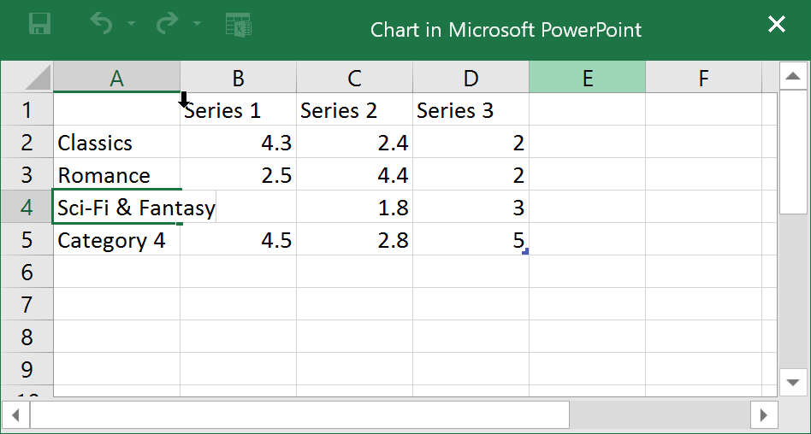
To insert a chart:
Enter data into the worksheet.

Slide 23
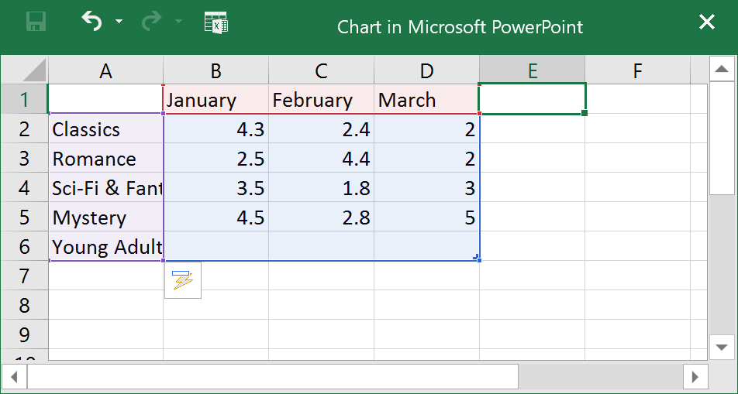
To insert a chart:
Only the data enclosed by the blue lines will appear in the chart, but this area will expand automatically as you continue to type.

Slide 24
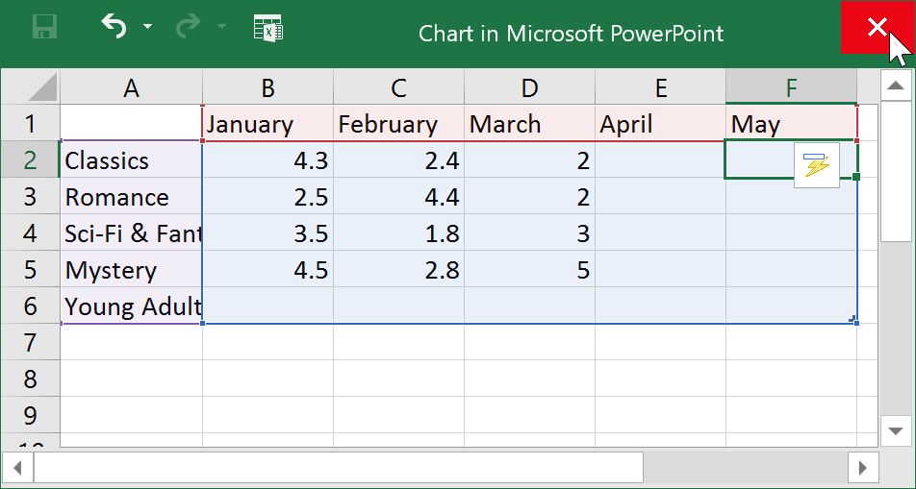
To insert a chart:
When you're done, click X to close the spreadsheet.

Slide 25
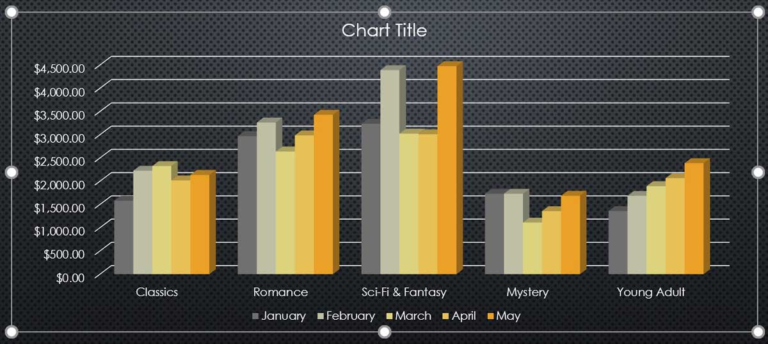
To insert a chart:
The chart will be completed.

Slide 26
Modifying charts with chart tools
There are many other ways to customize and organize your charts. For example, PowerPoint allows you to change the chart type, rearrange a chart's data, and even change the layout and style of a chart.

Slide 27
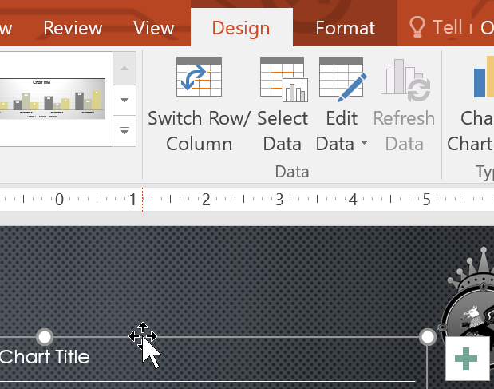
To change the chart type:
If you find that your data isn't well suited to a certain chart, it's easy to switch to a new chart type. In our example, we'll change our chart from a column chart to a line chart.
Select the chart you want to change. The Design tab will appear on the right side of the Ribbon.

Slide 28
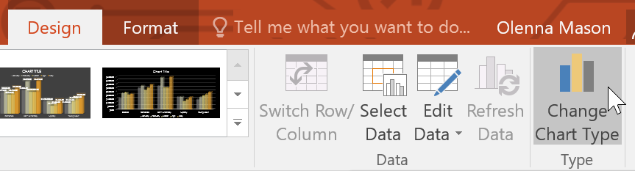
To change the chart type:
From the Design tab, click the Change Chart Type command.

Slide 29
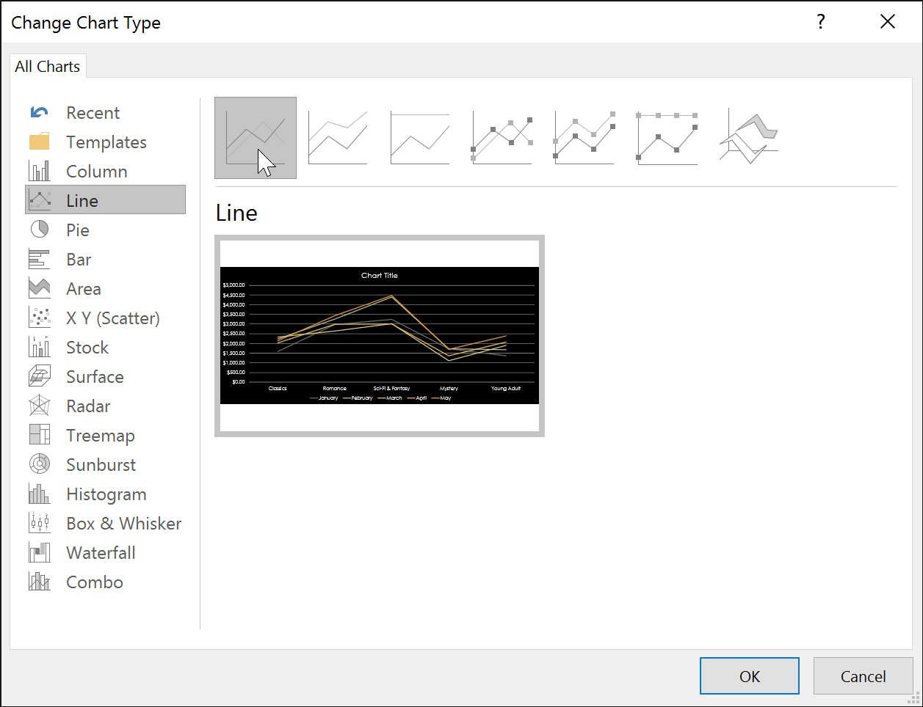
To change the chart type:
A dialog box will appear. Select the desired chart type, then click OK.

Slide 30
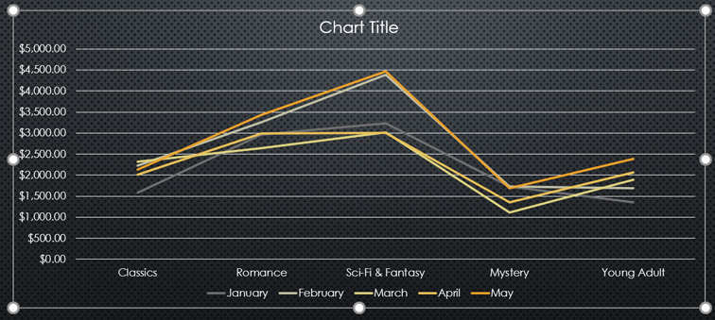
To change the chart type:
The new chart type will appear.

Slide 31
To change the chart type:
The new chart type will appear.

Slide 32
To switch row and column data:
Sometimes you may want to change the way charts group your data. For example, in the chart below the book sales data is grouped by genre, with lines for each month. However, we could switch the rows and columns so the chart will group the data by month, with lines for each genre. In both cases, the chart contains the same data; it's just organized differently.

Slide 33
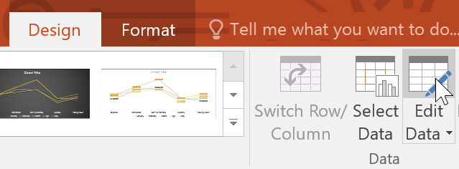
To switch row and column data:
Select the chart you want to modify. The Design tab will appear.
From the Design tab, select the Edit Data command in the Data group.

Slide 34
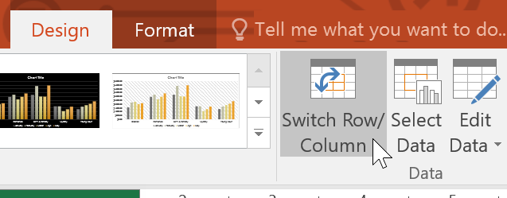
To switch row and column data:
Click the chart again, then select the Switch Row/Column command in the Data group.

Slide 35
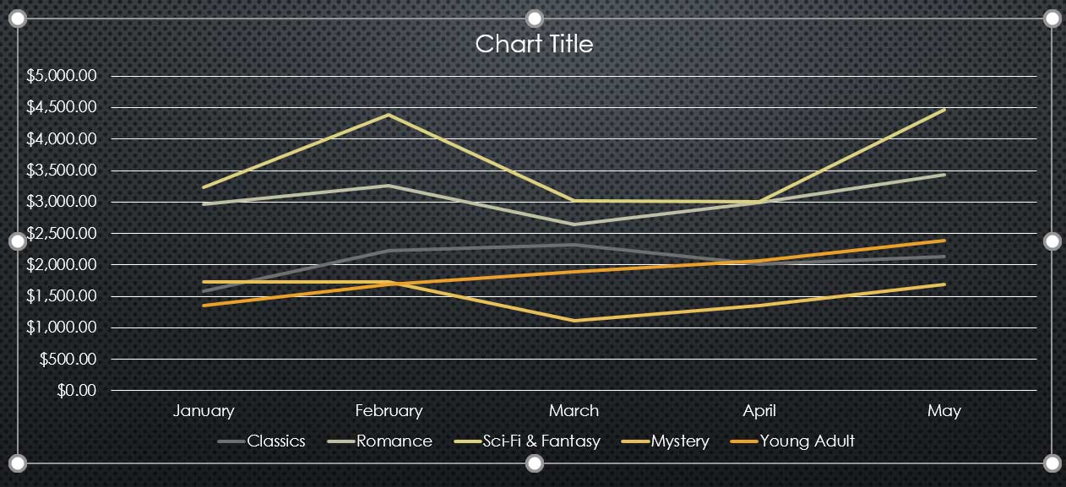
To switch row and column data:
The rows and columns will be switched. In our example, the data is now grouped by month, with lines for each genre.

Slide 36
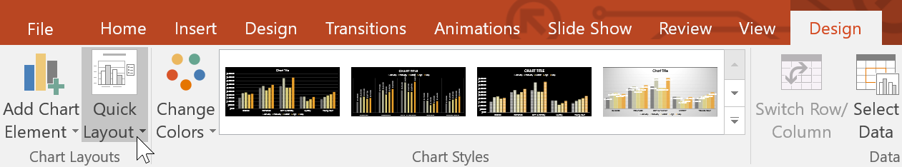
To change the chart layout:
Predefined chart layouts allow you to modify chart elements—including chart titles, legends, and data labels—to make your chart easier to read.
Select the chart you want to modify. The Design tab will appear.
From the Design tab, click the Quick Layout command.

Slide 37
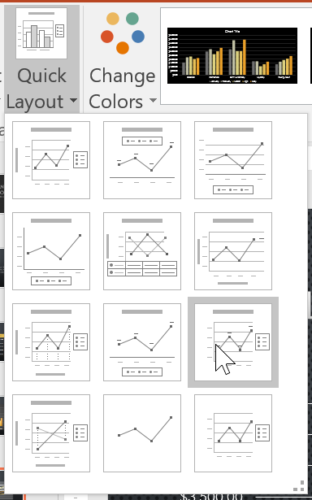
To change the chart layout:
Select the desired predefined layout from the menu that appears.

Slide 38
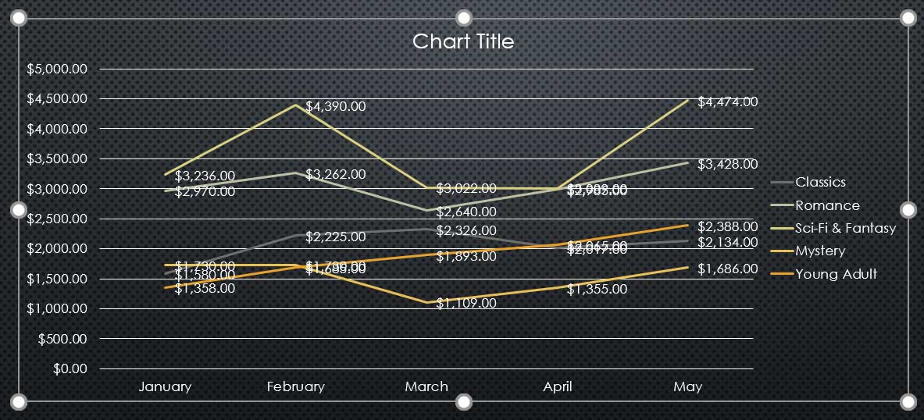
To change the chart layout:
The chart will update to reflect the new layout.

Slide 39
JOBSHEET
Continue working

Slide 40
THANKS!

